Slide 1
Pre Data Analysis of Health Information Survey
Presented By:
Sheethal Sridhar

Slide 2
Understanding the Data
Independent Variable Categories:
Looking for Health Information
Internet Usage
Health Care
Accessing Medical Records
General Health Status
Physical Activity Information
Household Information
Dependent Variable Categories:
Portal Usage Type:
Never used
One time used
Continuously used
Different Data Types:
Binary (Yes/No)
Numerical
Categorical

Slide 3
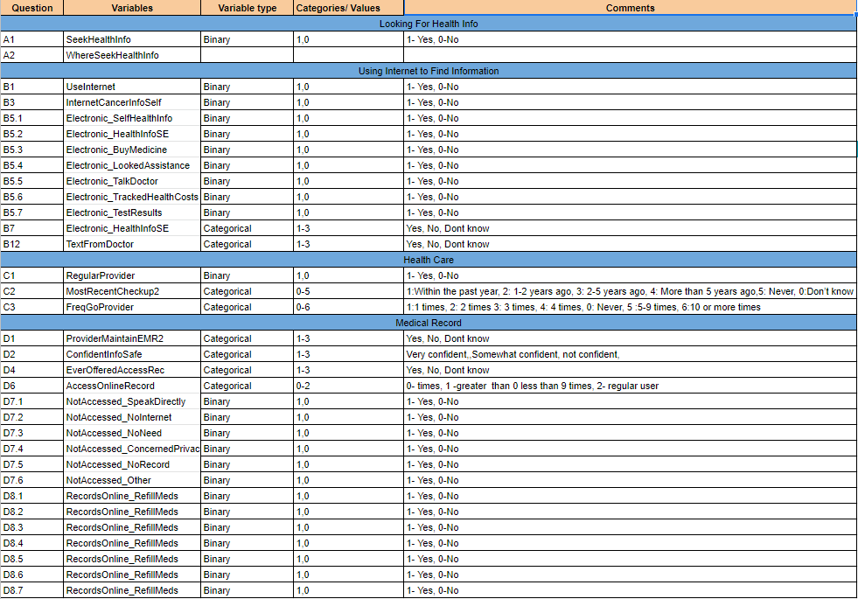

Slide 4
Data Preparation: Cleaning the Data
Data Cleaning: Handling missing values, converting data to correct data types.
Multicollinearity: Ensuring to remove highly correlated values from the independent variable to avoid “double counting.”
Feature reduction: Eliminate the variables which may not be useful
Notes:
Check for outliers and handle accordingly, either by removing them or replacing them with mean or mode.
Correlation - Reduce dimensionality by using features which are highly correlated with the dependent variable. Removing the “Worst Predictors.”

Slide 5
Analyze the Data and Model Selection
Univariate and Multivariate Analysis for feature distribution understanding and remove potential outliers.
Create a Training and Validation set to perform model validation and optimization.

Slide 6
Model Selection
Why Random Forest?
One of the most accurate decision models.
Works well on large datasets.
Handles Missing values.
Works well for categorical data.
Can be used to extract variable importance.
Do not require feature engineering (scaling and normalization).
Notes:
Cons:
Overfitting in case of noisy data.
Unlike decision trees, results are difficult to interpret.
Hyperparamters needs good tuning for high accuracy.

Slide 7
Interpreting the Results
Seperate users into three Categories of Portal Usage:
Never Used
Used Once
Continuously Used
Create tables and visualizations to determine the similarities of the users in each category to assess the characteristics of users in those categories.

Slide 8
Questions

